Slide 1

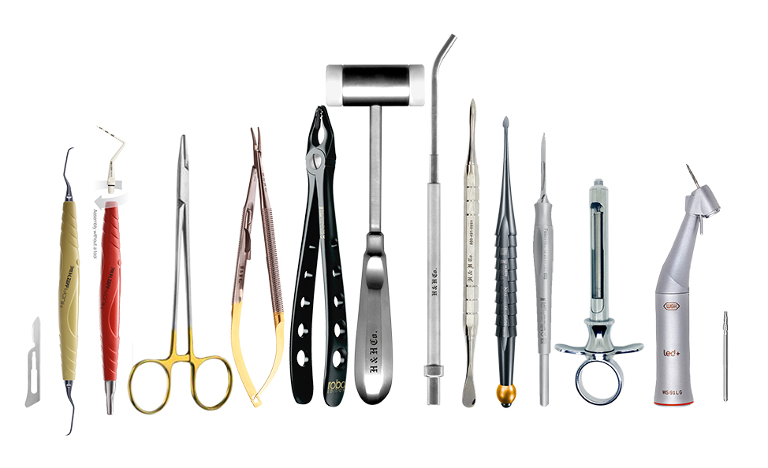
Manufacturing Quality Instruments in the U.S.A. Since 1985
& Selling the Finest Germany Products
www.hhcompany.store
800-491-9989

Slide 2
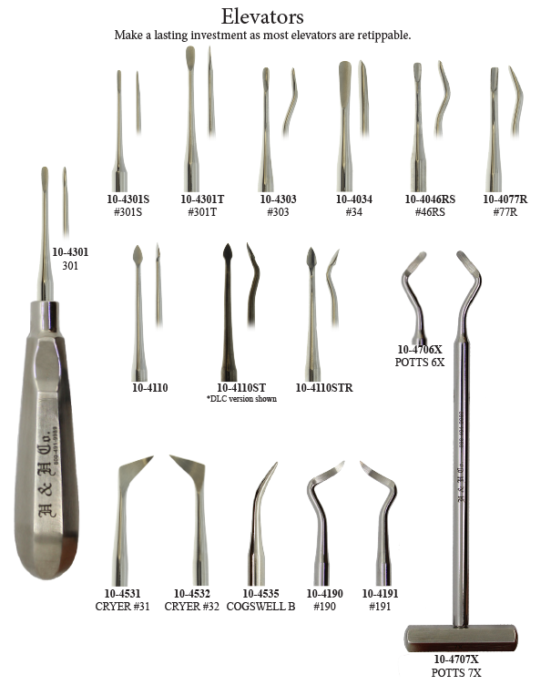
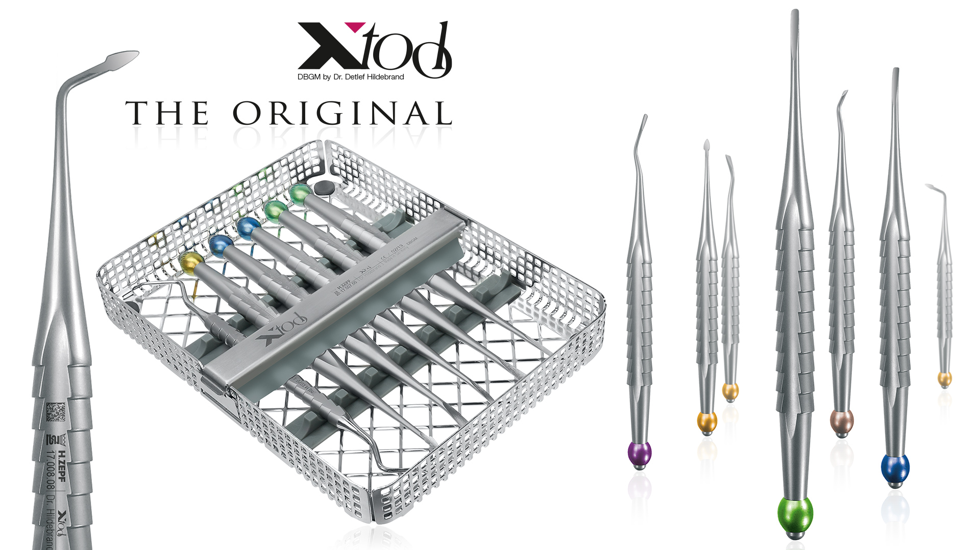
www.hhcompany.store
800-491-9989

Slide 3
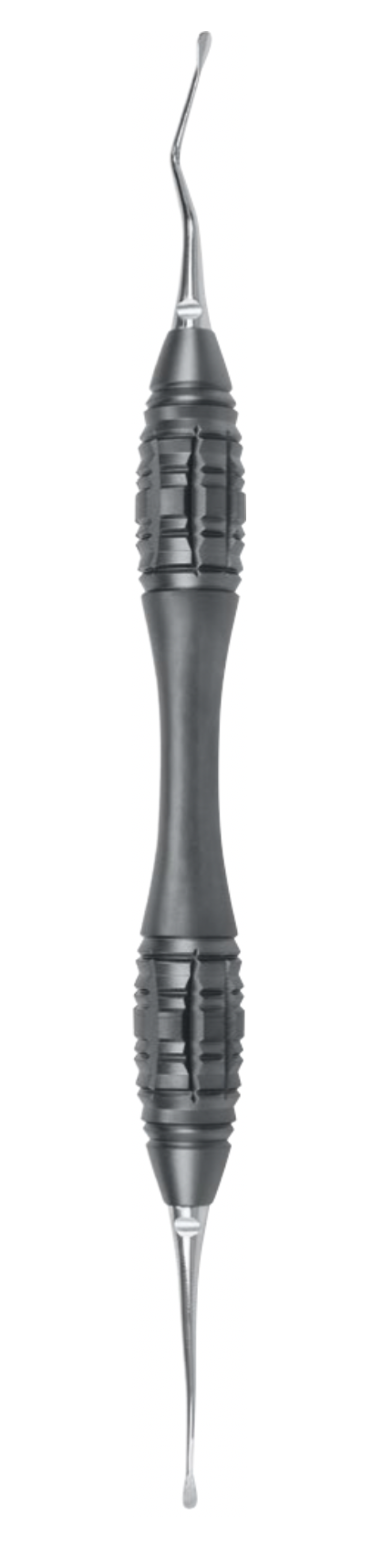
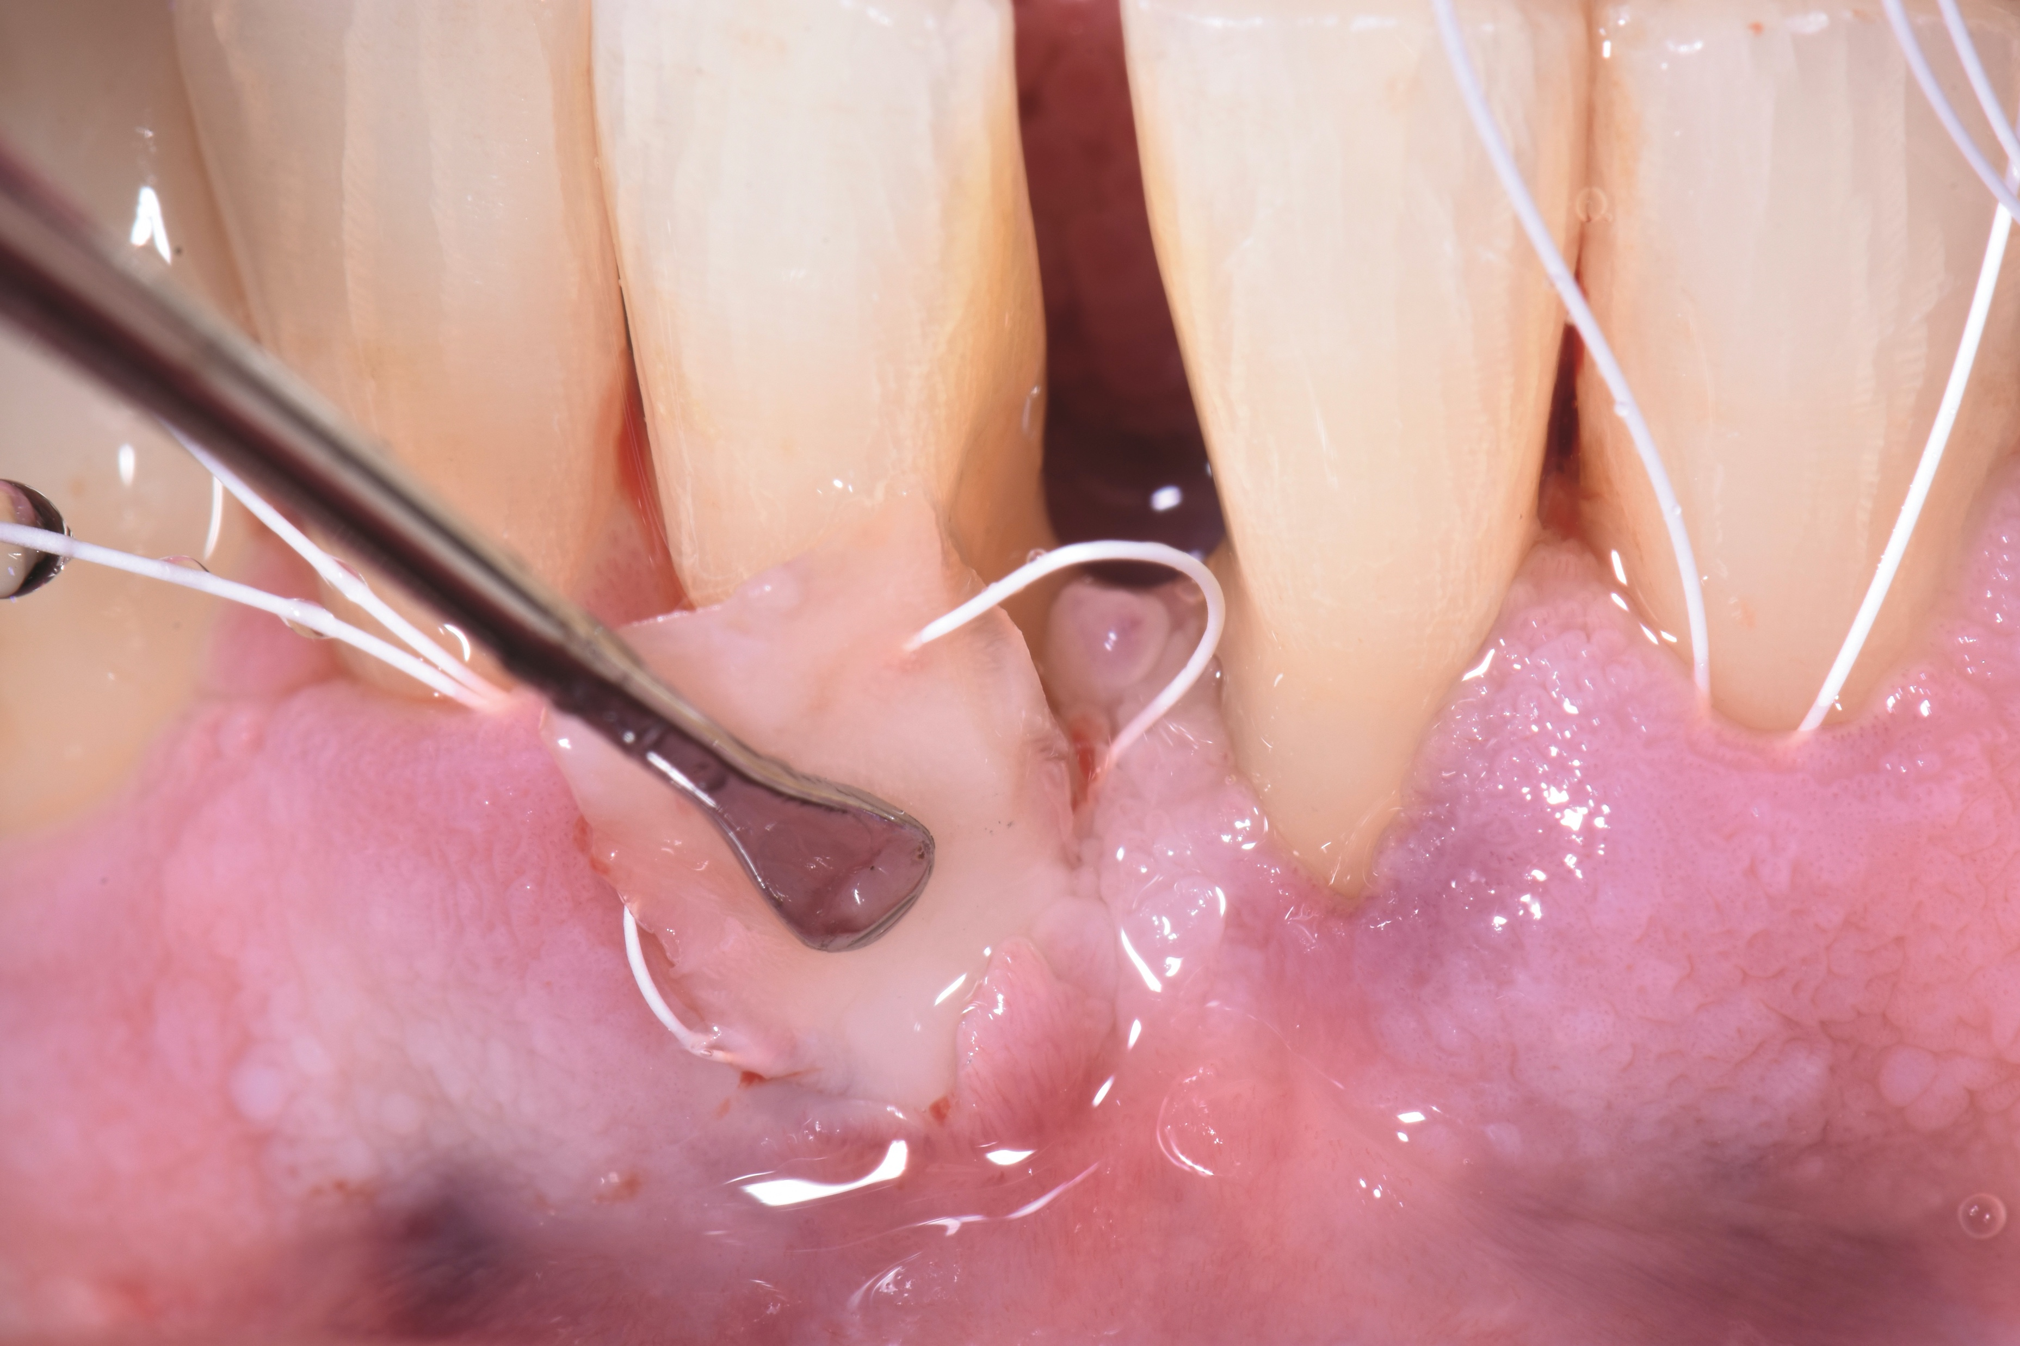
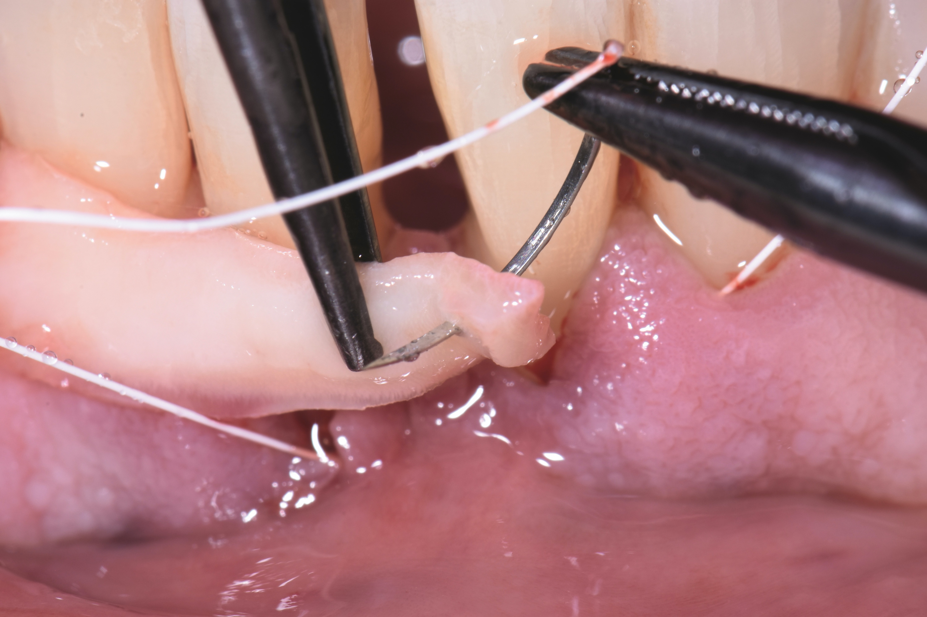
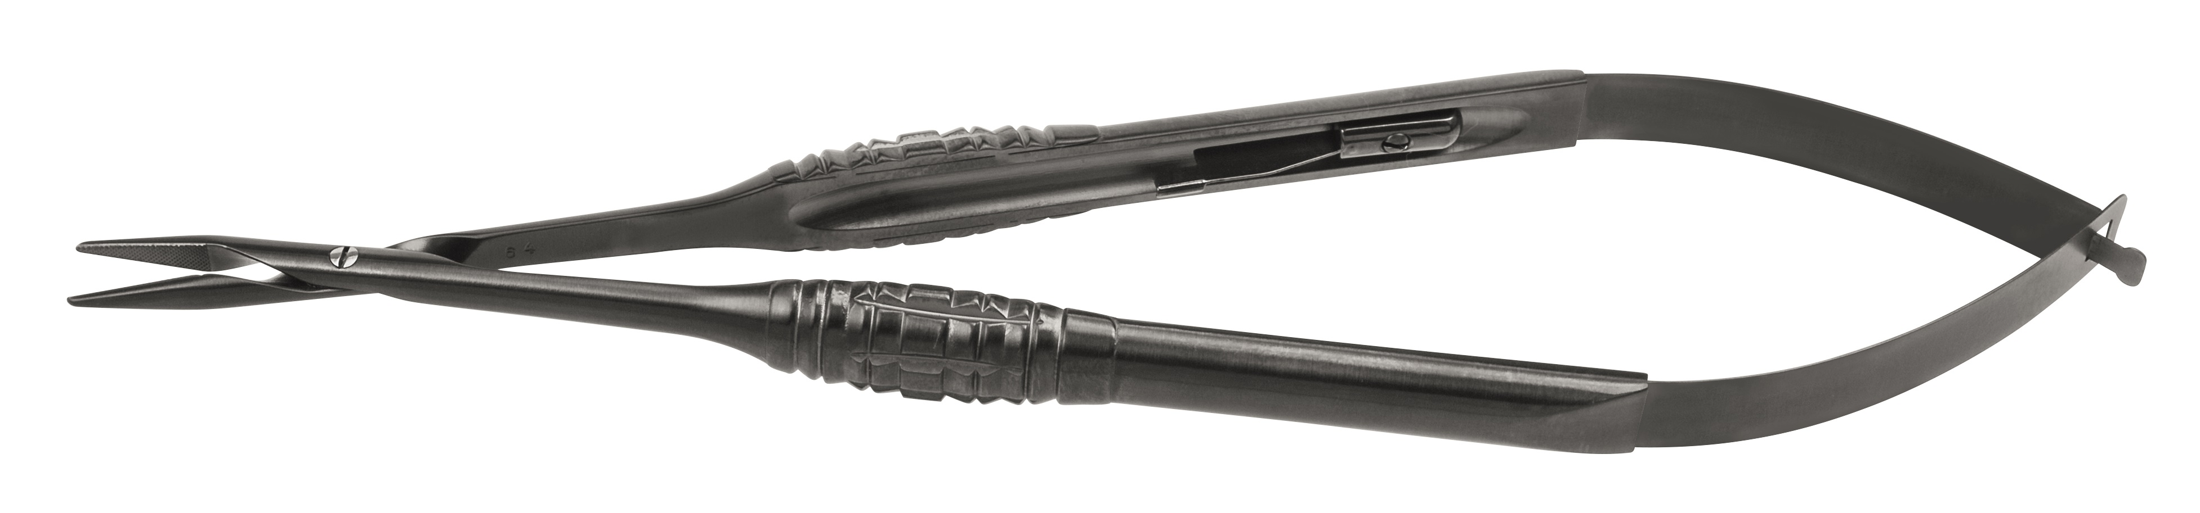
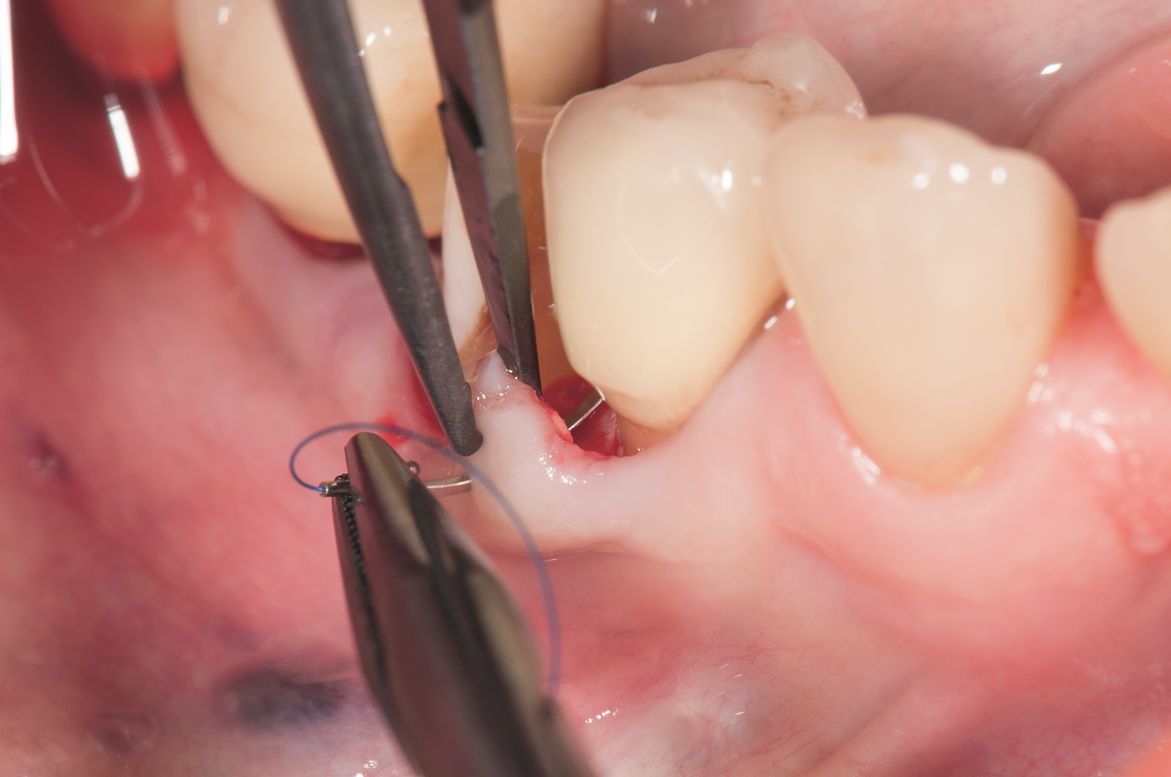
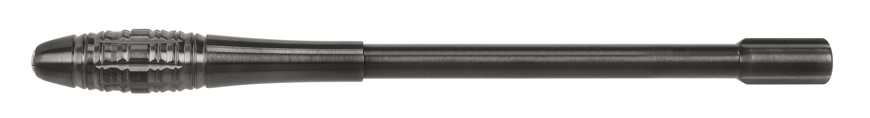
Micro TOUCHGRIP Instruments for periodontal micro surgery acc. to Otto Zuhr and Prof. Dr. Markus Hürzeler
www.hhcompany.store
800-491-9989
Tunneling Instrument
46.035.20HZU
Micro Needleholder
41.010.17HZU
Micro Scalpel Handle
46.013.00HZU
20+ Instruments Available in the HZU style

Slide 4
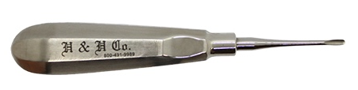
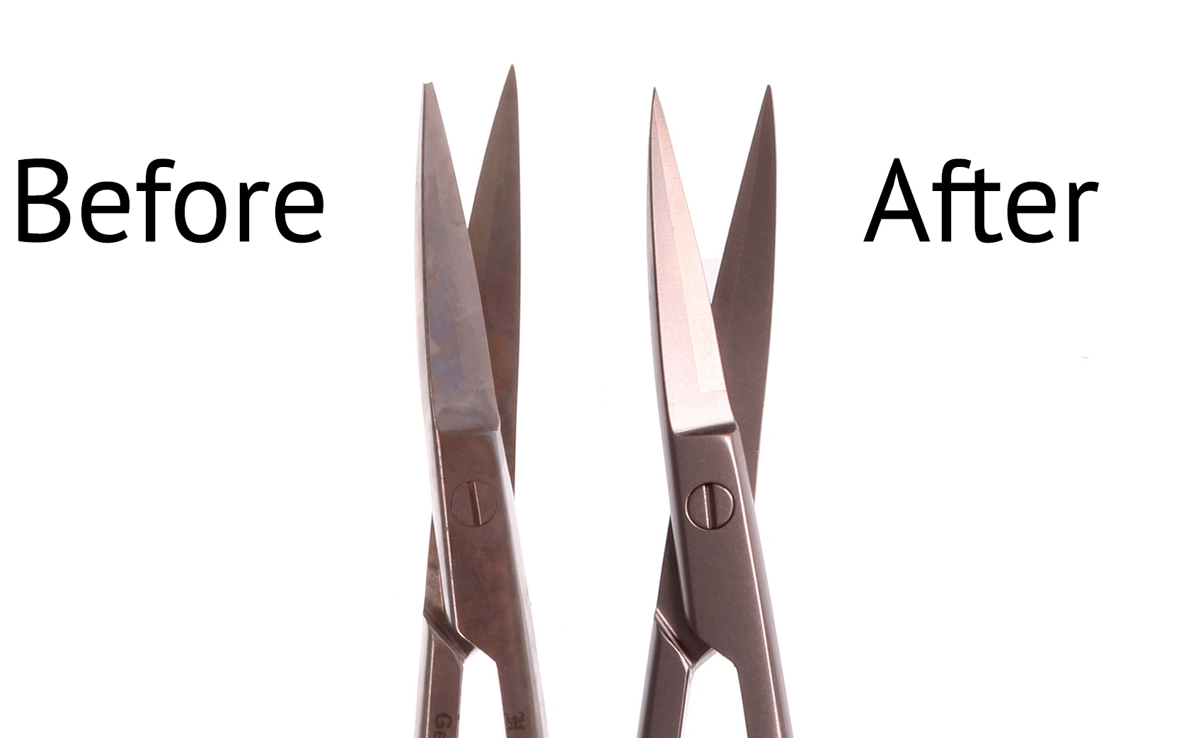
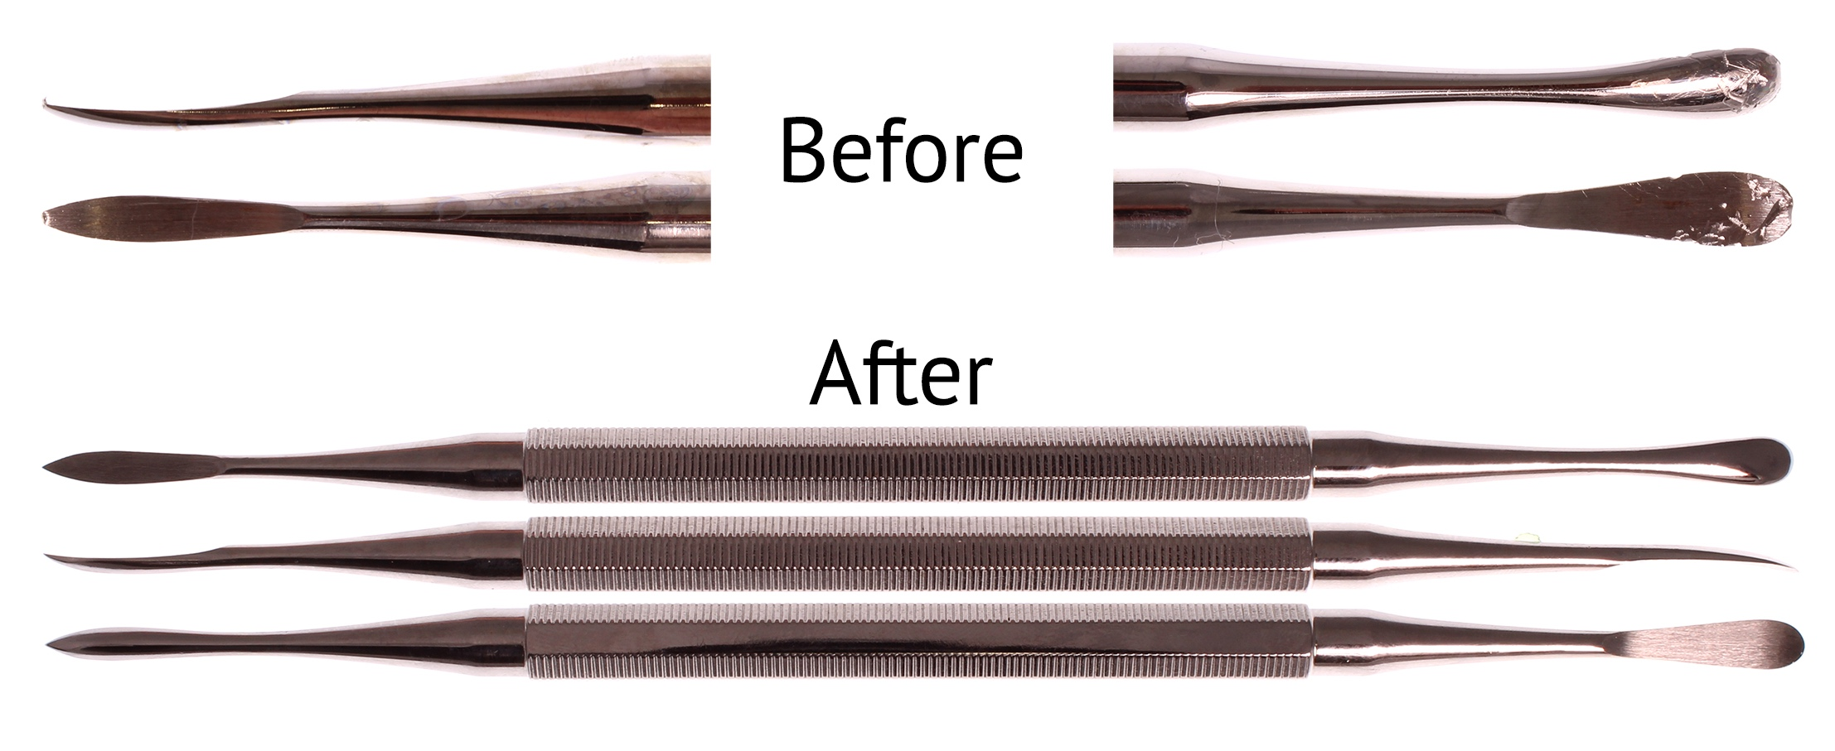
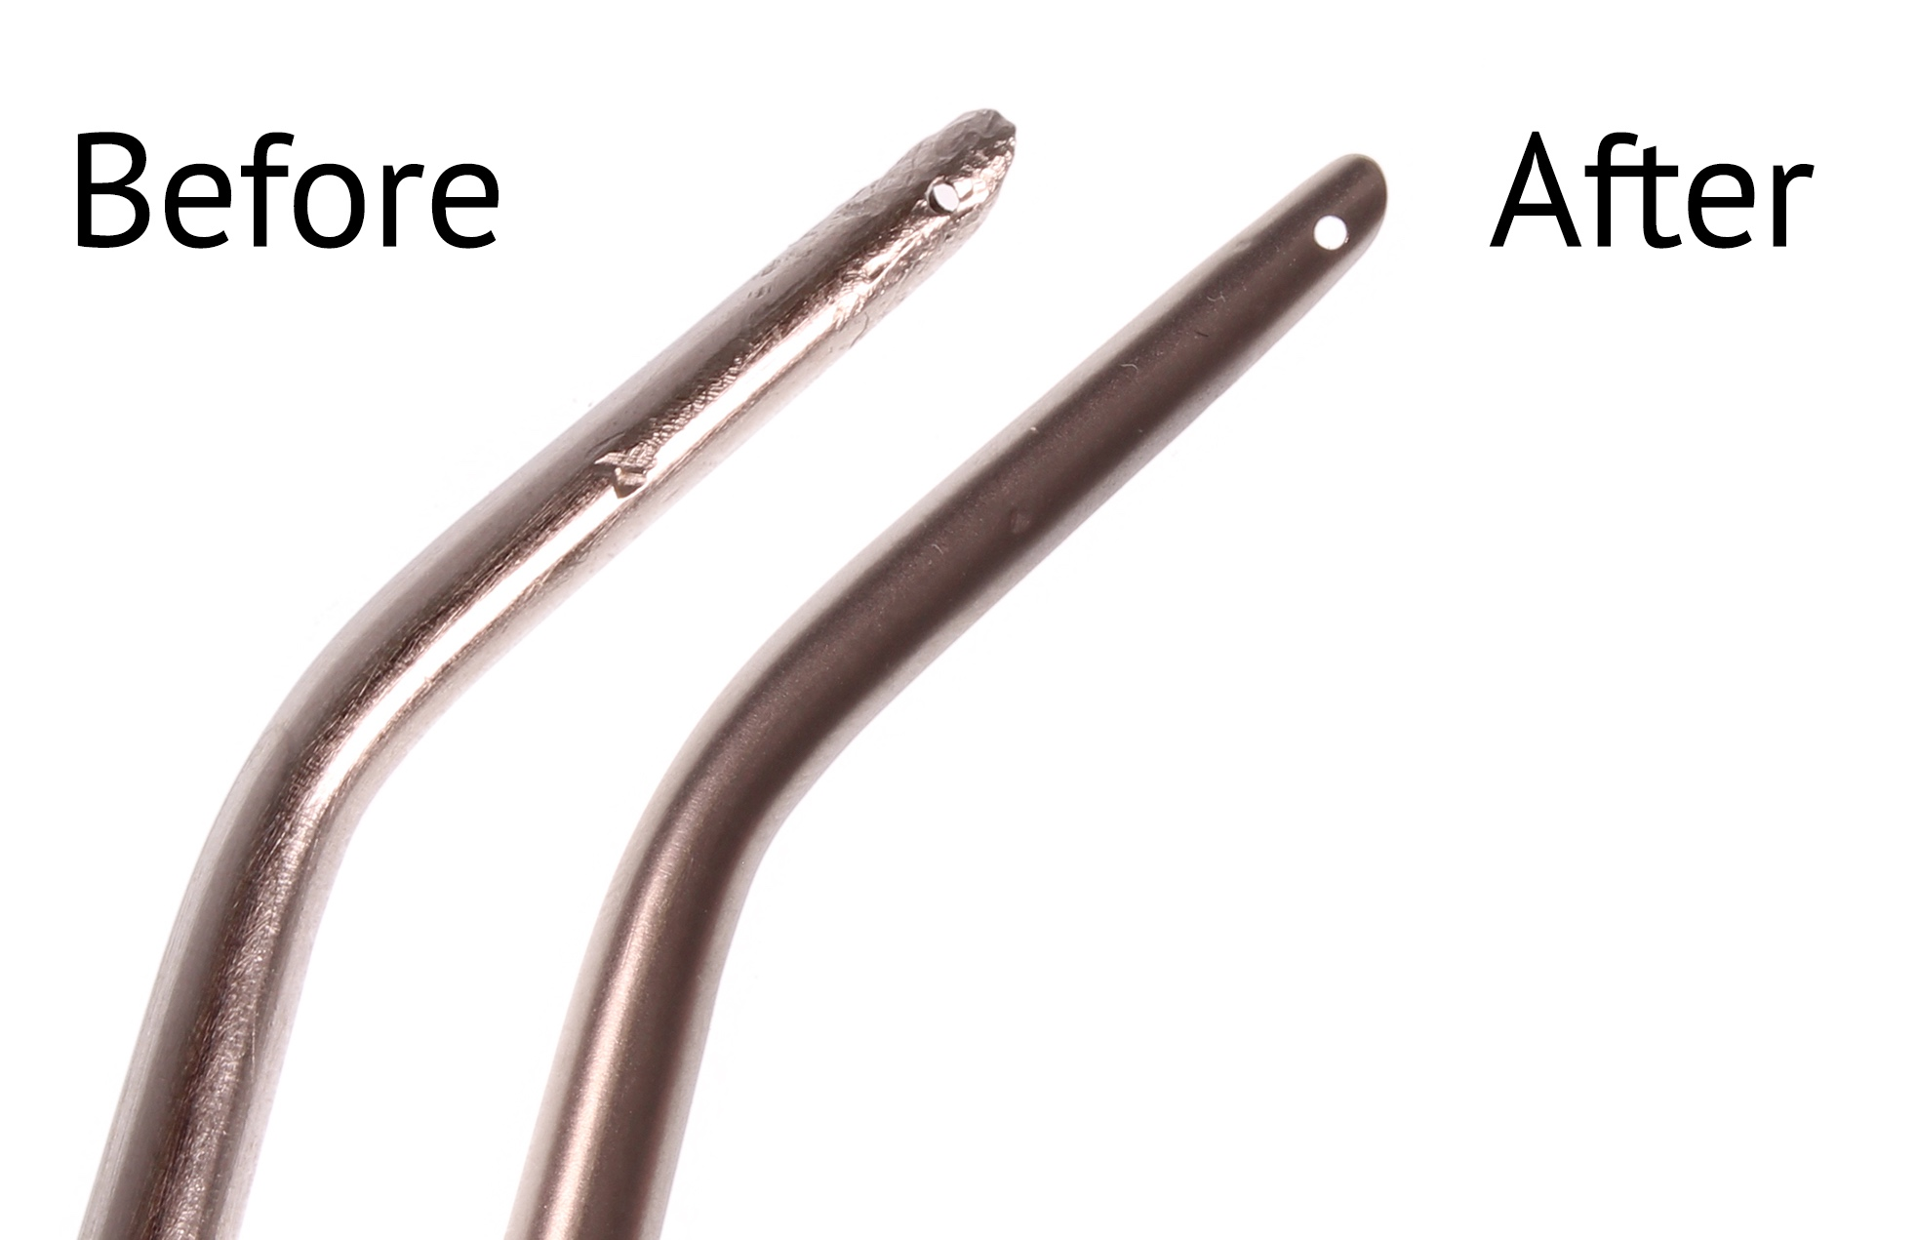
www.hhcompany.store
800-491-9989
Sharpening, Reconditioning & Retipping Services
Elevator Retip Stainless Steel: $26
Scissor - Reconditioning Stainless Steel: $18.50
Periosteal Elevators - Reconditioning Stainless Steel D/E: $15.50
Suciton tips - Reconditioning
Stainless Steel w/ hole: $13.75
Jan 2020

